Slide 1


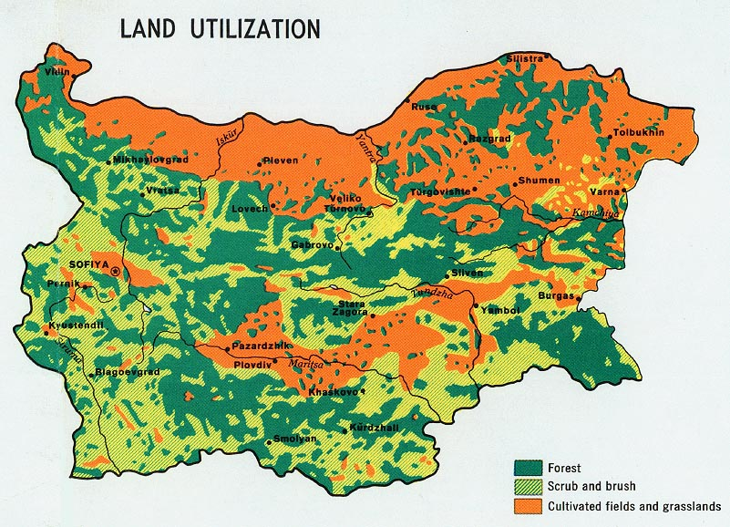
INSTITUTE FOR ENTREPRENEURSHIP, SUSTAINABLE DEVELOPMENT AND INNOVATION
Impact of climate change on agriculture in Bulgaria: Mitigation & Adaptation
ALAN THODEY, IESDI
First webinar on the project “Active farmers for CCA”, AU-Plovdiv
06.04.2021 г.

Slide 2
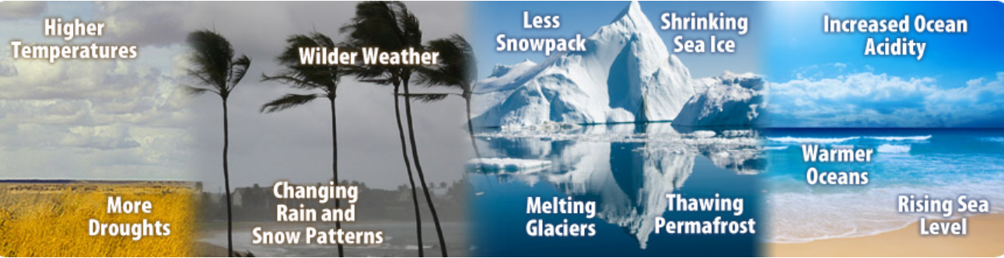
What are the elements of climate change
Increased heat and more extreme temperatures…heat waves
Decreased rainfall and more intense droughts…declining water supplies
More extreme rainstorms…flooding, erosion
Warming oceans and rising sea levels…affecting weather patterns
Increased insect and disease outbreaks

Slide 3
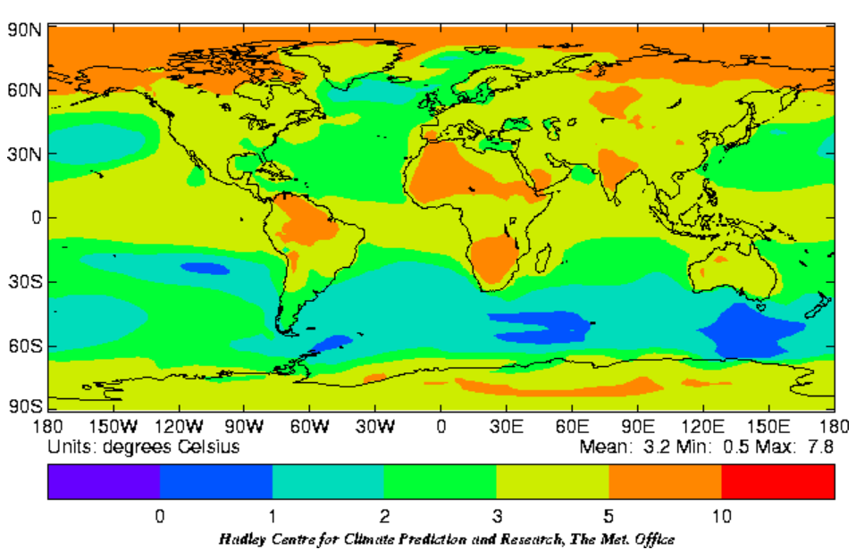

Change in average annual surface temperature from 1960-1990 to 2070-2100…Simulaiton

Slide 4
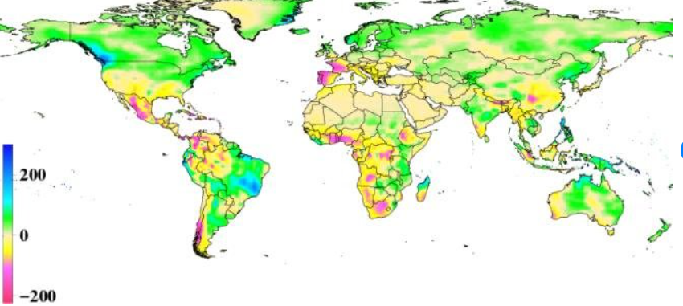
Change in average rainfall from 2000 to 2050
Change in average annual precipitation (mm), 2000-2050, A1B IPCC scenario simulation

Slide 5
Impact of climate change on crops
Changes in length of growing season
  Based on air temperature…earlier spring…later autumn
  For thermophilic crops, allows for more optimal timing
    Corn harvest earlier…during August by 2050
    Winter wheat harvest earlier… by 1-2 weeks by 2050
  Allows for new crops…second cropping
Agro-phenology…changes to timing of phenological phases
  Fruit flowering and ripening earlier
  Longer growing season for vines/other crops
  For grains, reduced flowering to ripening time reduces time for grain filling
Crop yields…based on growing season & crop growth
  Will likely rise initially and then fall in the Balkans due to latitude
  In lower latitudes, already falling without adaptation

Slide 6
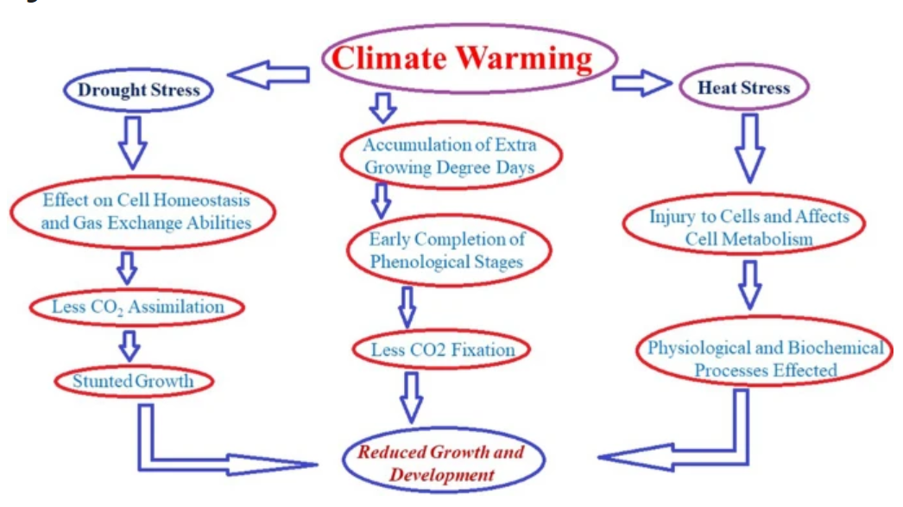
Impact of climate change on crops

Slide 7
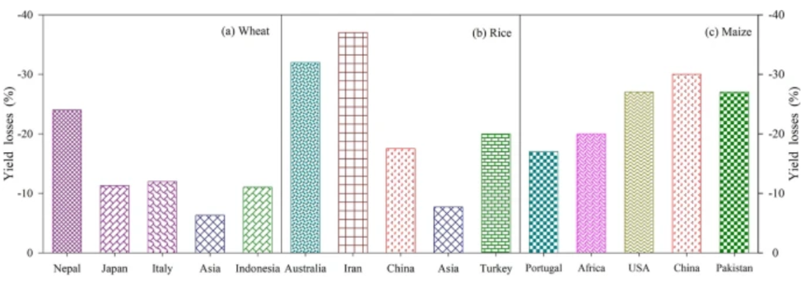
Impact of Climate Change on Crop Yields

Slide 8
Impact of climate change on livestock
Livestock breeding will be adversely affected by greater heat stress
  Negatively effects reproduction, metabolism, health
Fodder and pasture resources will be compromised
  Reduces availability of fodder and grazing resources
  Will change feeding patterns…requiring higher grain input
  Increases risk of overgrazing and erosion on pasture lands
Increased pressure for meat alternatives
  Consumers will change their consumption behavior due to increased concern for environmental impact of meat production and increasing prices of meat

Slide 9
Impact of climate change on pests, diseases and weeds
Increases risk of pests and diseases
  Will shorten the reproductive cycle of pests
  Will stimulate the growth and generation of fungi, insects & other pests
  Will change the interactions between pests and their natural enemies and hosts
Increases risk of weeds
  Will stimulate the growth and generation of weeds
Will impact food safety and security
  Will lead to increased use of pesticides, weedicides, veterinary drugs, etc.…Will impact the food chain

Slide 10
Impact of climate change on soils
Increased Risk of Soil Erosion and Desertification
  Increased incidence of heavy rain storms, with high intensity and short duration, will generate increased short-term surface runoff and increase the risk of soil erosion
  More frequent and intense droughts will impact soil organic matter decomposition and increase the release of carbon dioxide and nitrates
  Hot winds, will increase the risk of wind erosion and soil degradation
  Combination of environmental factors may trigger irreversible change in the plant-soil system resulting in desertification
Increased Risk of Soil Degradation
  Soil degrades due to water and wind erosion, pollution, reduction of organic matter stocks (humus), compaction, acidification, salinization, loss of biodiversity
  65 percent of the cultivated land area in Bulgaria is threatened by varying degrees of water erosion
  24 percent of the cultivated land area is threatened by wind erosion

Slide 11
Impact of climate change on water requirements and availability
Increased water requirements and availability
  Higher temperatures and lower relative humidity will increase water needs for evapotranspiration in agriculture
  However, this will be partially offset by increased carbon dioxide levels in the atmosphere that will result in higher water use efficiency due to reduced transpiration and an increased rate of photosynthesis
  Reduced rainfall will increase water deficit in soils
Risk of water shortage for storage and impact on irrigation
  Reduced precipitation will lower water reserves (both surface and groundwater) and reduced accumulation will result in less water for irrigation
  Reduced availability will result in increased competition for water from urban water users and will reduce availability of water for irrigation

Slide 12
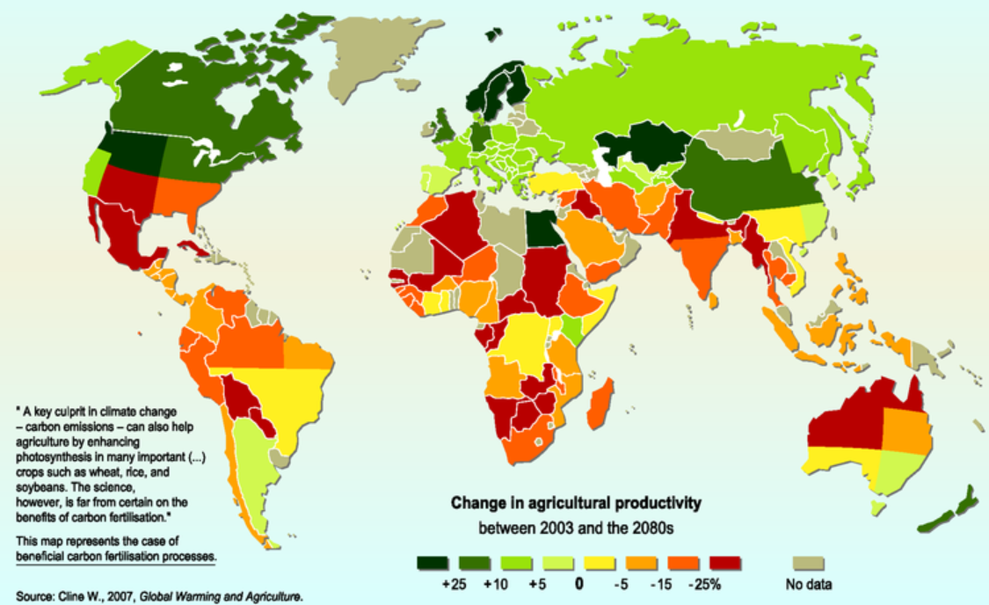
Impact of climate change on agriculture to 2080

Slide 13
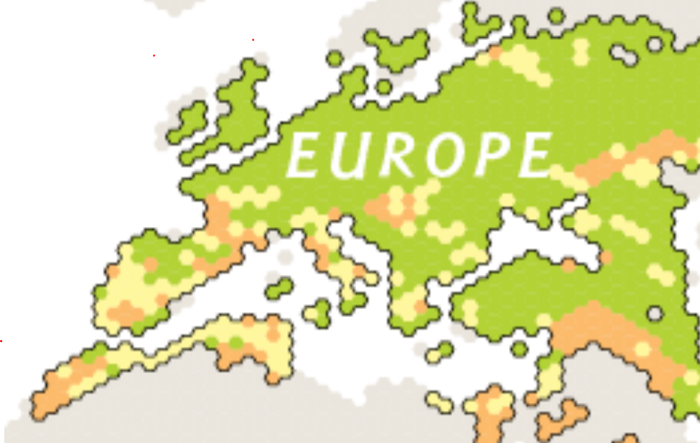
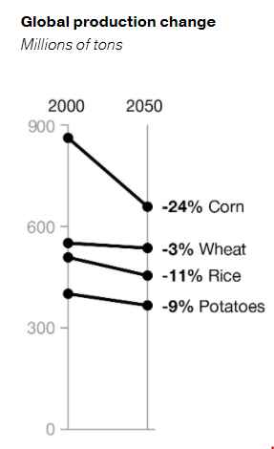
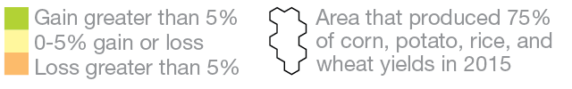
Change in potential average yields for corn, potatoes, rice, and wheat in 2050…simulation study

Slide 14
Change in wheat yields in 2050 compared to 2010 due to new technology…simulation study
Technology used to impact yields (% change by 2050 compared with 2010 baseline with no assumed other changes in technology) (Source: International Food Policy Research Institute, 2014) | E.Europe & C. Asia | Global
Conservation Farming (No-till planting with minimum or no soil disturbance, often in combination with resi­due retention, crop rotation, and use of cover crops) | 9.31 | 16.4
Precision agriculture (GPS-assisted delivery of agricultural inputs & low-tech management practices to control all field parame­ters, from input delivery to plant spacing to water level) | 9.51 | 9.7
Heat tolerance varieties (improved varieties showing characteristics that allow the plant to maintain yields at higher temperatures) | 2.93 | 9.3
Drought tolerance varieties (improved varieties showing characters that allow the plant to have better yields compared to regular varieties due to enhanced soil moisture uptake capabilities and reduced vulnerability to water deficiency) | 2.69 | 1.4
Improved nitrogen use efficiency varieties (improved varieties showing enhanced NUE) | 2.19 | 6.2
Crop protection—diseases (effects of chemical treatment against diseases) | 5.26 | 4.2
Crop protection—insects (effects of chemical treatment against insects) | 3.32 | 3.3
Crop protection—weeds (effects of chemical treatment against weeds) | 4.20 | 3.4

Slide 15
Mitigation and adaptation to climate change in agriculture
Cultural practices
  No-till planting, reduced tillage
  Increased crop rotations with more diverse crops, change cropping patterns
  Change sowing and harvesting dates…climate warming accelerates crop growth and shortens duration of phenological phases of cereals due to heat stress…results in physiological processes (eg photosynthesis, starch conversion and nutrient metabolism) being negatively affected
  Change planting geometry (eg decreased plant density, broader plant or row to row distance, and skip-row configurations) to improve micro-climate, increase leaf coverage and better utilize soil moisture…Planting geometry affects solar radiation interception, canopy coverage, crop growth rate and biomass accumulation
  Plant cultivars better adapted to the changing climate

Slide 16
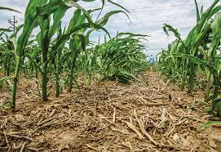
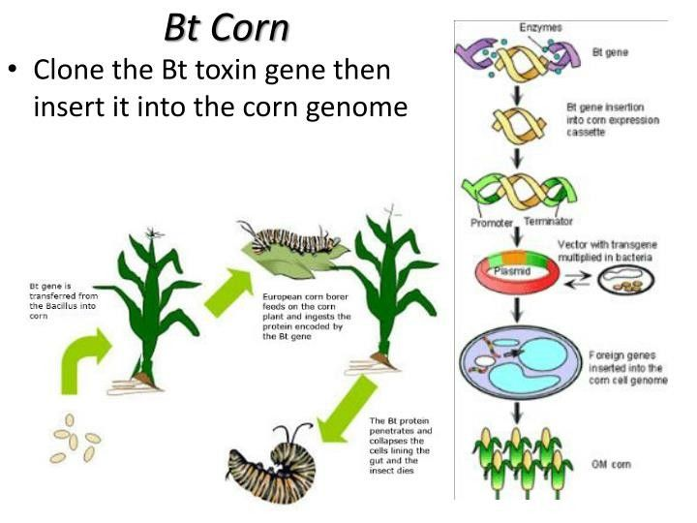
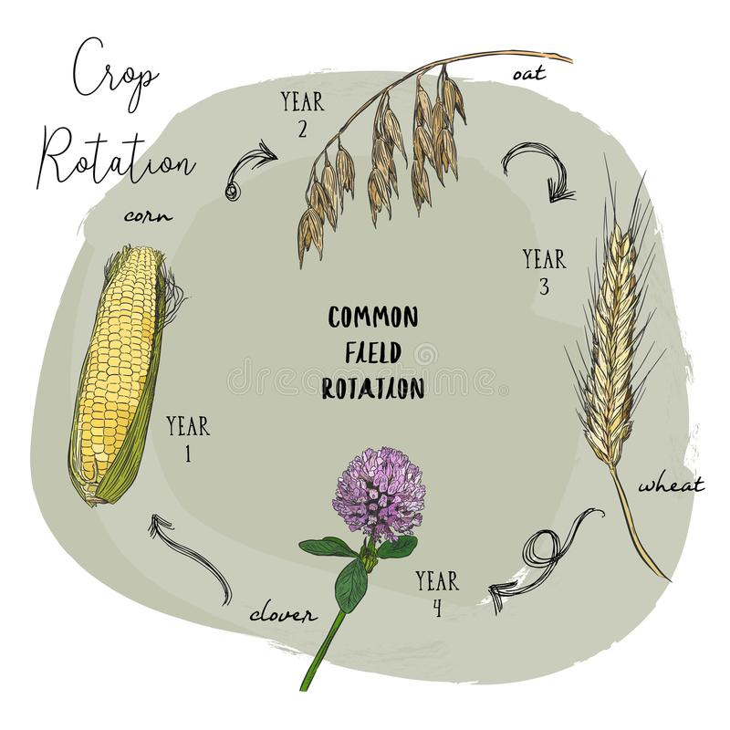
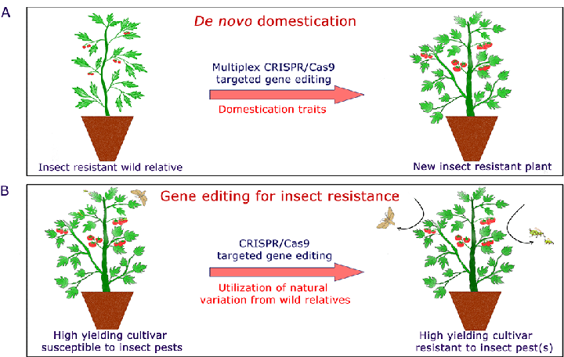
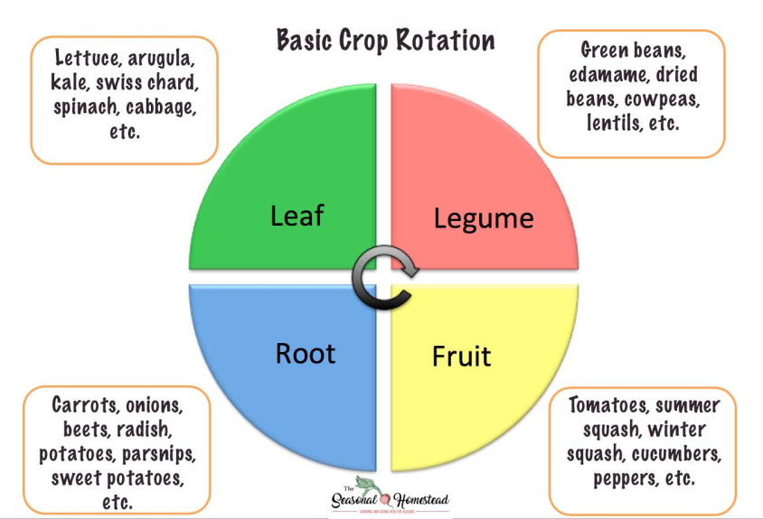
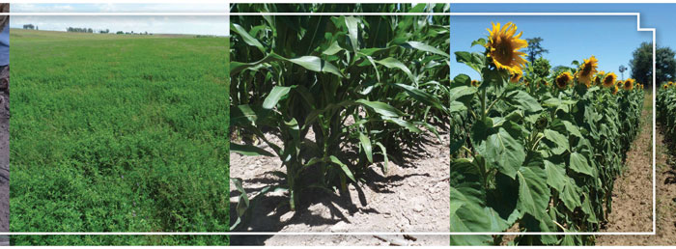
No Till; Cover Crops; Plant Breeding; Crop Rotation

Slide 17
Breeding more adaptive plants and livestock
Plant breeding for:
  Heat tolerance…reduced stress
  Early or late maturity
  Drought tolerance…reduced stress
  Reduced water requirements
  Resistance to insects and diseases
  Ability to control weeds
Livestock breeding for:
  Tolerance for extreme heat, particularly in reproduction and feed conversion
  Breed with native breeds that are more tolerant of extreme conditions

Slide 18
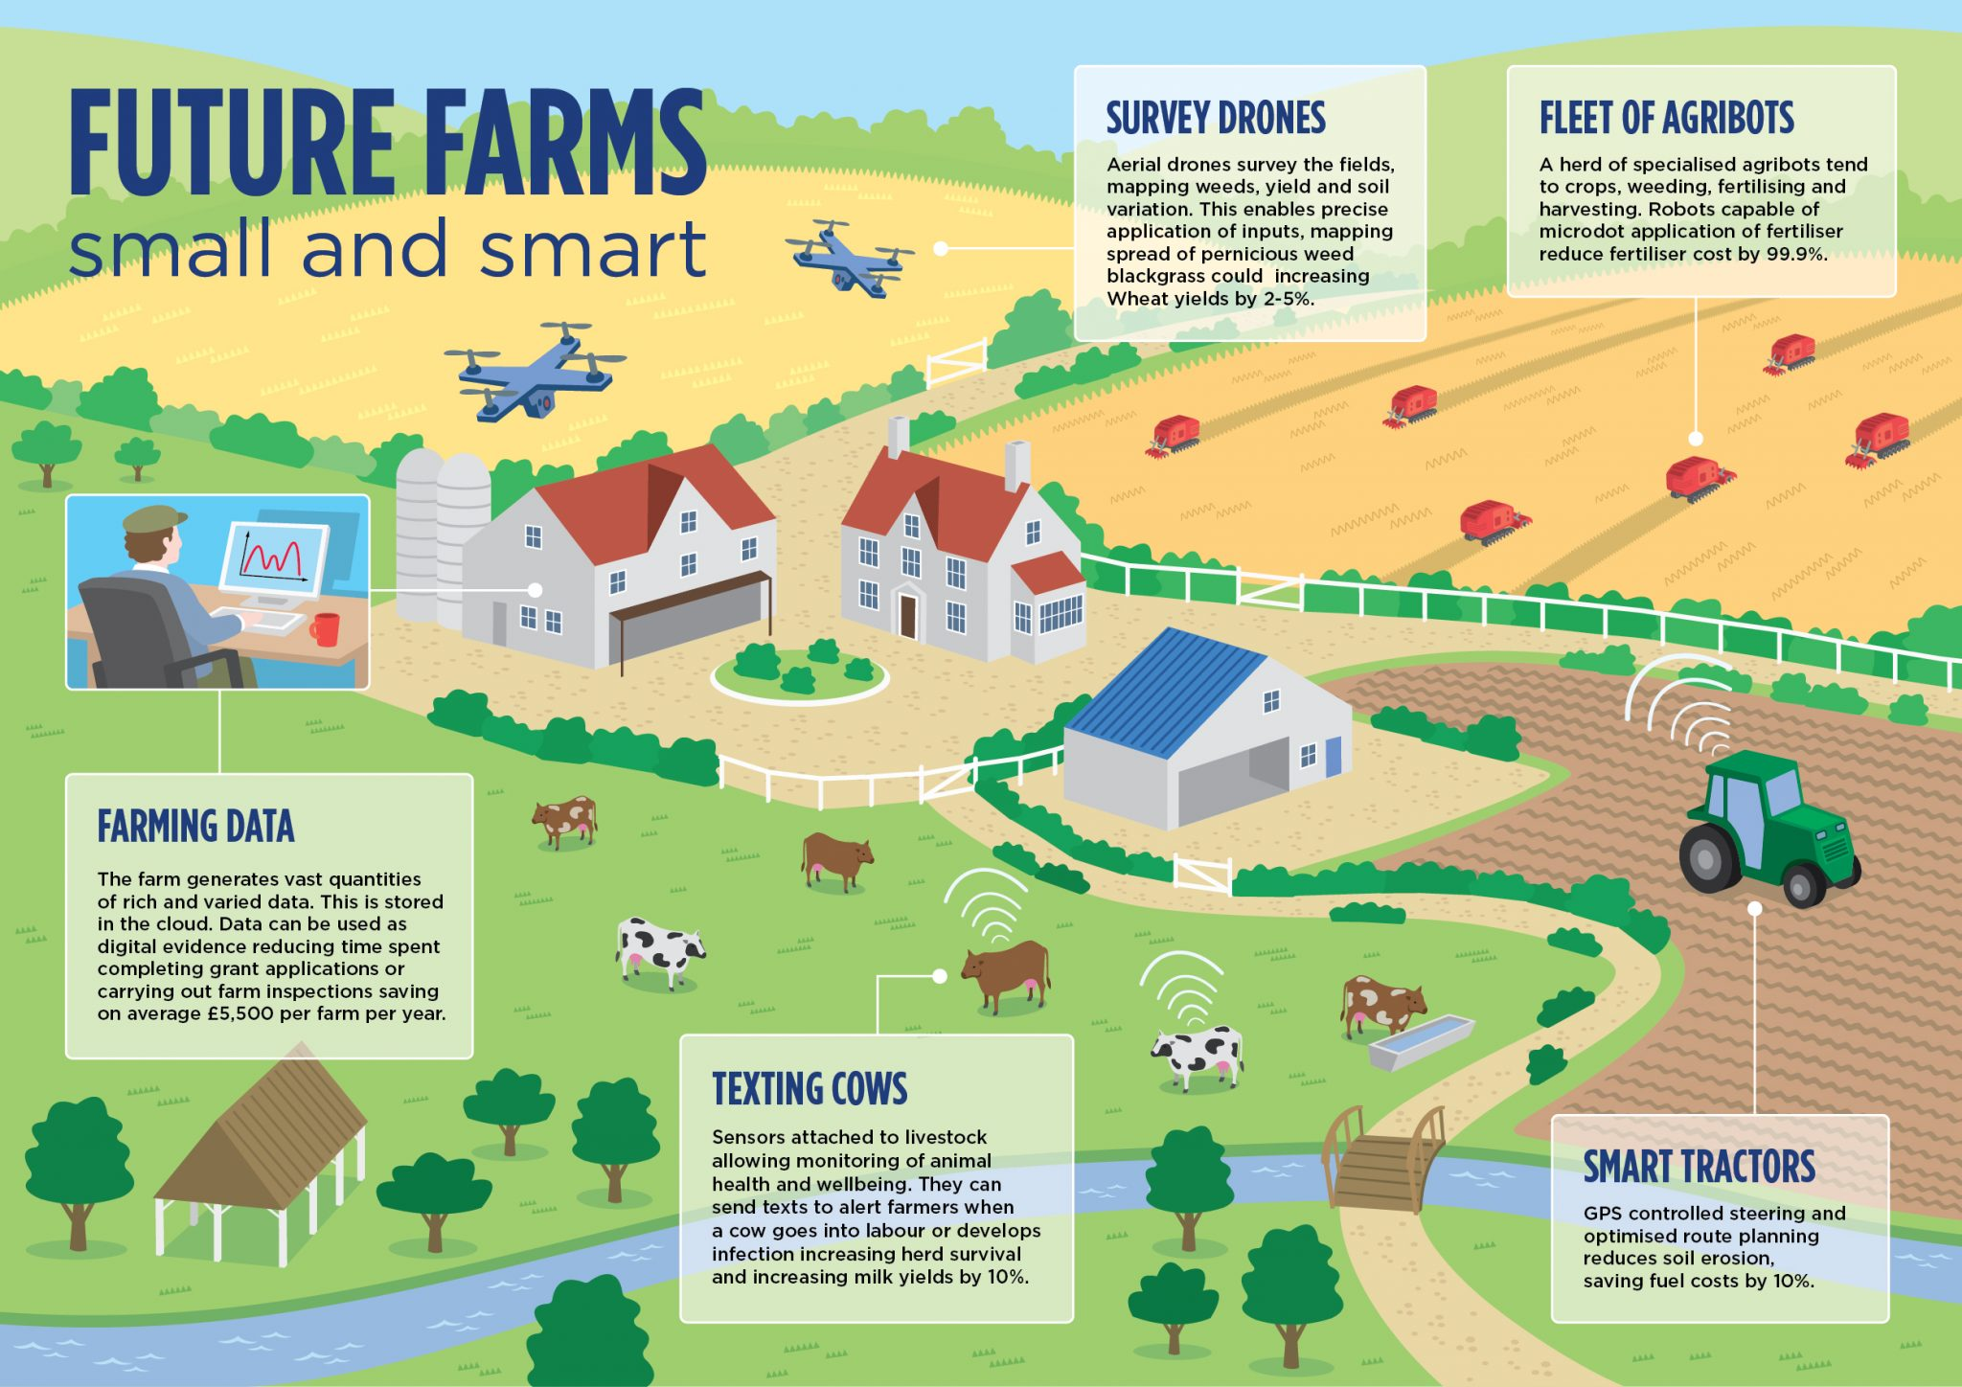
Adopt smart farming equipment & practices

Slide 19
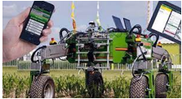
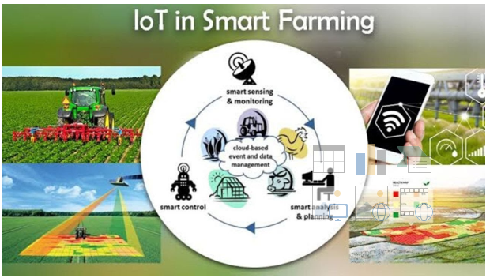
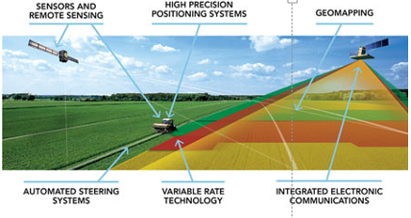
Digital Farming is the future…precise, efficient & cost effective…but requires scale & knowledge

Slide 20
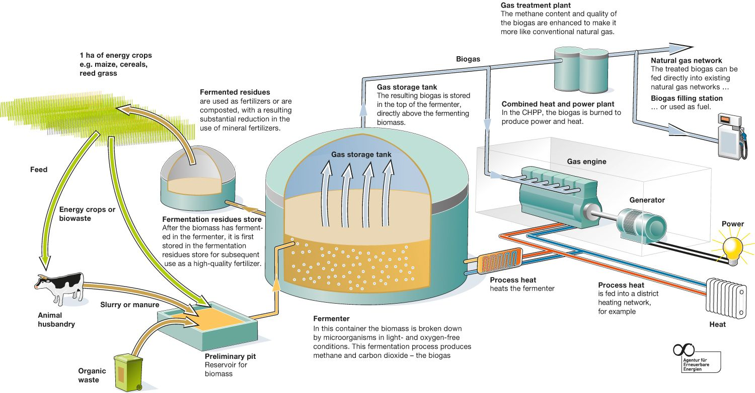
Agriculture needs to use renewable energy…solar, wind
& biogas (Anaerobic Fermentation)

Slide 21
Action Plan: National and Regional Level (1)
Government needs a clear and well funded plan to promote and advance sustainable farming…with specific objectives on adoption
The government plan needs to be broadly and clearly presented as a priority
Officials need to be better educated regarding sustainable agriculture
Officials need to be more directly involved in promoting sustainable farm practices and work closely with all stakeholders
An effective training program is required to better train agronomists, counselors and others working with farmers
Communication channels with farmers need to be more extensive and targeted
  This could be built around the National Agricultural Advisory Service

Slide 22
Action Plan: National and Regional Level (2)
Research into sustainable practices needs to be expanded and results promoted—a database of sustainable practices needs to be established & made easily available on the web to all stakeholders
Bureaucracy needs to be reduced/minimized
Significant public and private financial resources need to be made available to farmers
Subsidies should be targeted to better promote sustainability e.g. as a condition of eligibility in the CAP program
Rural infrastructure needs to be expanded e.g. irrigation, internet (high speed broadband), roads
Farmers need to be supported in taking the risks associated with adopting sustainable practices

Slide 23
Action Plan: Farmers and Agri-business
Education of farmers needs to be expanded to emphasize the importance of sustainable practices; their economic, social & environmental benefits along with their steps for implementation
Training of farmers on business management, planning, circular economy, climate change, internet services, digital/precision farming, etc.
Provide easy access to available knowledge on farm topics:
  The value of moving to improved varieties and higher value crops and products. Promote through demonstration and shared experiences
  The importance of marketing, the value of labeling and pricing power
  Improved production practices & digital/mechanization alternatives
  Availability of financial resources and access to subsidies
  Sustainable practices, e.g. green energy, input reduction, composting, reuse/recycling

Slide 24
Action Plan: Consumers
Programs are needed to educate consumers on the value of products produced using sustainable practices in order to broaden the market and enhance prices…and why sustainably produced food is important to them
Organic products need to be promoted for their increased value
Special packaging and labeling of sustainably produced products should be encouraged in order to enhance demand and prices
Consumers need to be educated on ways to reduce food waste
Consumers need to be educated on the tradeoffs between animal- and plant-based meat products

Slide 25
Moving forward
Assign responsibility within government for planning and implementing an effective program on sustainable farming
Hold those responsible accountable for achieving quantifiable and qualitative goals, including the attitude and performance of farmers and consumers
Build a research and extension capability in support of sustainable farming
Use leading farmers to promote sustainable farming and to encourage change at the “grass roots” level

Slide 26
Questions?

